Slide 1
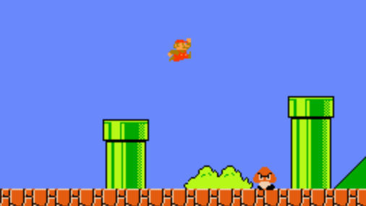
CS 4200 Final Project
Aryan Miriyala
Cedric Dortch
Super Mario Reinforcement Learning Agent
Group 16

Slide 2
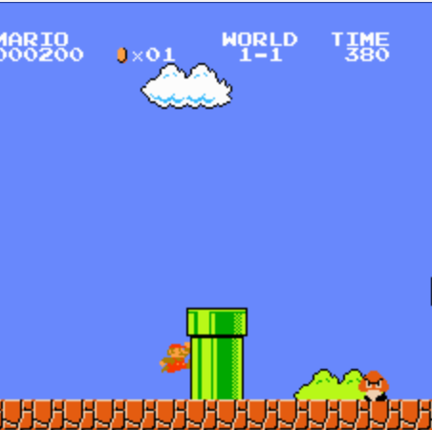
Contents in this
Presentation
Why Super Mario?
Defining the Environment
Reinforcement Learning
Proximal Policy Optimization
Deep Q-Network
Results
Challenges
Conclusion

Slide 3
Why Super Mario?
Popular game and an interesting topic in the context of AI
Dynamic environment with tons of strategies
The game is easily accessible through OpenAI Gym
Extensive studies have been made on Super Mario Ai

Slide 4
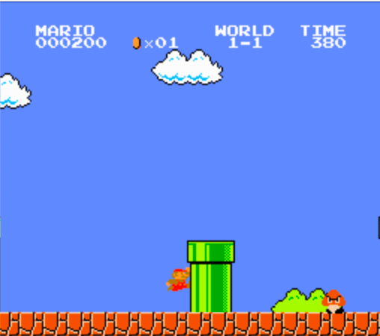
Defining the environment
Super Mario World PEAS representation
  Performance: Reach the end of the level
  Environment: The game world, the enemies, platforms, power ups
  Actuators: The actions that are taken by Mario. We are restricted to SIMPLE_MOVEMENTS this time.
  Sensors: Elements that provide information about the current state, position of Mario, obstacles and enemies.
Action Space is restricted to cut down the amount of data that needs to be consumed
A technique called gray scaling is used to cut down the data to be processed to 1/3rd

Slide 5
Defining the environment
We utilized the concept of wrapping our environment in different contexts to make use of several tricks to train our model
Super Mario has a huge state space and action space, so brute force would take forever to converge
Learning rate: Telling our model how important the new information learned should be. We take a really low number for a gradual convergence to the optimal value
Gray Scaling, Frame Stacking, Resize Wrapping and Skip Framing are some concepts we are going to employ

Slide 6
Reinforcement Learning – Our Approach
Learning how to maximize expected rewards based on observed transitions
A machine learning approach to help software make decisions
Imagine a Markov Decision Process, but we have no idea what the transition probabilities and reward functions are
The agent explores the environment within the actions provided and learns what the optimal actions for a state are to maximize the reward
We are going to talk about two popular algorithms that deal with reinforcement learning, especially when it comes to game training agents – Proximal Policy Optimization and Deep Q-Network

Slide 7
Let’s talk about a few strategies before
Gray Scaling:
  A strategy that converts colored images to gray scales, which in turn reduces the amount of computation we need to do and store
  RGB colors are converted to gray scale which reduces the amount of computation to a third
Skip Framing:
  Used to skip several frames in the environment that need to be processed
  Computing data for each frame can become burdensome, so skipping a few frames reduces the load
  Accelerates training our model

Slide 8
Let’s talk about a few strategies before
Resize Operation:
  Resize the resolution of the frames processed to reduce data size
Frame Stacking:
  Stacks multiple frames together for multi framed observation
  Creates a sense of memory for the agent to look ahead and behind
  Helps see the obstacles and enemies ahead
DummyVec ENV:
  Helps with the vectorization of the environment
  Runs several copies of the environment in parallel

Slide 9
Why talk about these concepts?
The computation we will be performing to achieve a model close to optimal convergence is very high
Only way to do it with the resources available is to utilize strategies that reduce the amount of data that we look at
These strategies help us with doing exactly that
Even with all these strategies, running a training model is extremely difficult
We will talk about this later

Slide 10
CNN Policy (Convoluted Neural Network)
A specialized neural network architecture for analyzing visual data
Utilized convoluted layers to detect features such as the environment that it is in, the hurdles and the enemies
The policy automatically extracts from raw visual data
Very helpful for interpreting image frames, such as when gaming
Helps decision making for agents that are navigating complex environments

Slide 11
CNN Policy for a Mario agent
We are going to process the environment as a stack of frames or images that contain raw data for the agent
CNN policy analyzes game screen images to recognize important elements such as Mario, enemies, obstacles and power ups
Predicts optimal actions for the agent based on visual input
CNN policy with reinforcement learning algorithms helps our agent understand optimal actions
Continuous learning and adaptation helps with the decision-making process and improves on it continously

Slide 12
Proximal Policy Optimization (PPO)
Reinforcement Learning algorithm that trains agents to performs tasks where the actions impact future states and rewards
Focuses on optimizing the policy function mapping observed states to relevant actions
Iterative updates helps the agent learn to make better decisions, optimizing over time
Better for stability and efficiency in training neural networks
Clipping mechanism that limits the change in policy during each update, preventing large policy changes
Small step size, so convergence is reached at an optimal solution

Slide 13
Code Demonstration

Slide 14
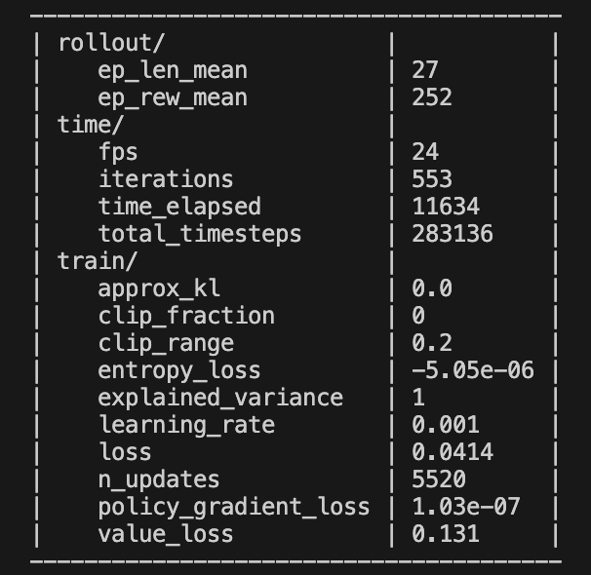
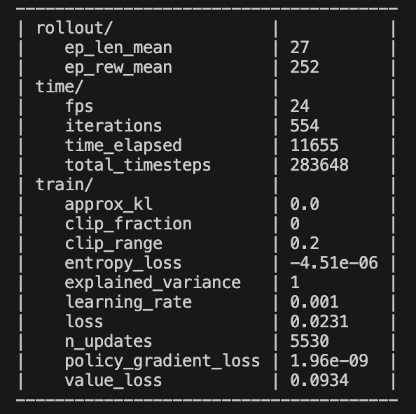
Running the Training Model

Slide 15
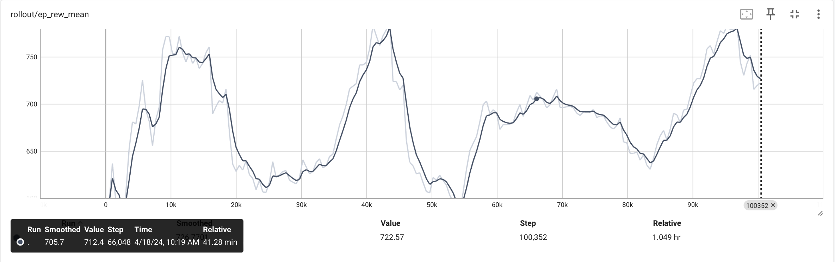
Let’s Talk Graphs – Episode Rewards

Slide 16
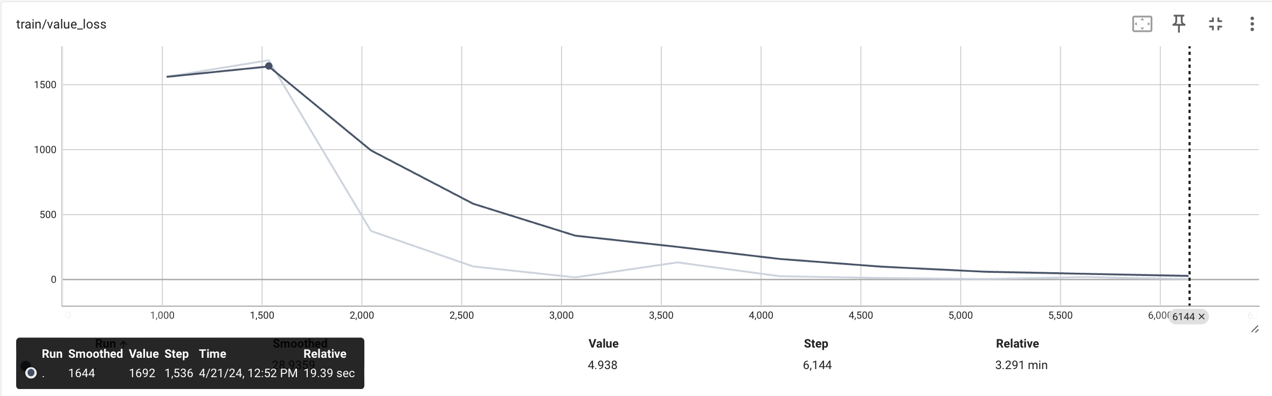
Let’s Talk Graphs – Value Loss

Slide 17
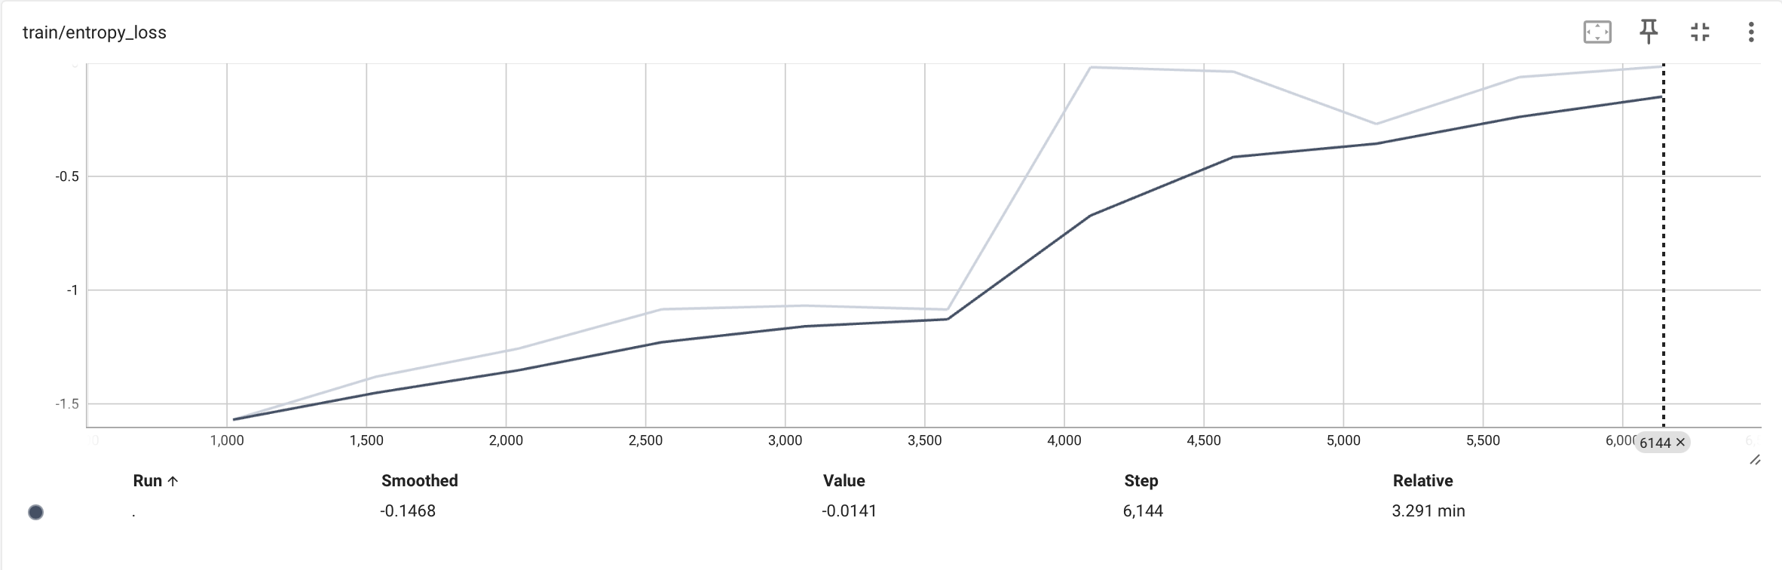
Let’s Talk Graphs – Entropy Loss

Slide 18
Challenges
Not having enough computation power and resources has been a big challenge for training this algorithm
As per our research, a total step size of 4 million is required for the PPO algorithm to converge at an optimal stage
That is where Mario can pass the level and achieve the dream run
I was able to have a total step size of 100,000 after which the algorithm breaks

Slide 19
Deep Q-Network (DQN)
A variant of Q Learning algorithm popular with Reinforcement Learning for game agents
A CNN is used to approximate the Q function
Experiences are stored in a replay buffer and updates the Q Network
Stability is improved with a Target Network which is a copy of the Q-Network which is periodically updated with values from Q-Network

Slide 20
Code Demonstration

Slide 21
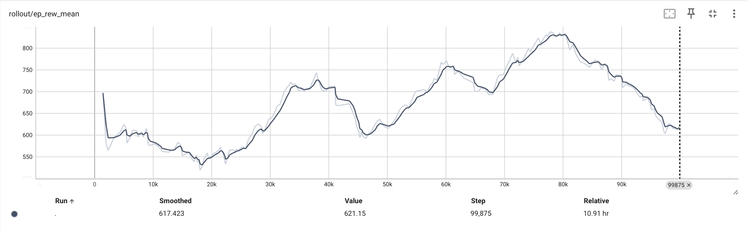
Let’s Talk Graphs – Episode Rewards

Slide 22
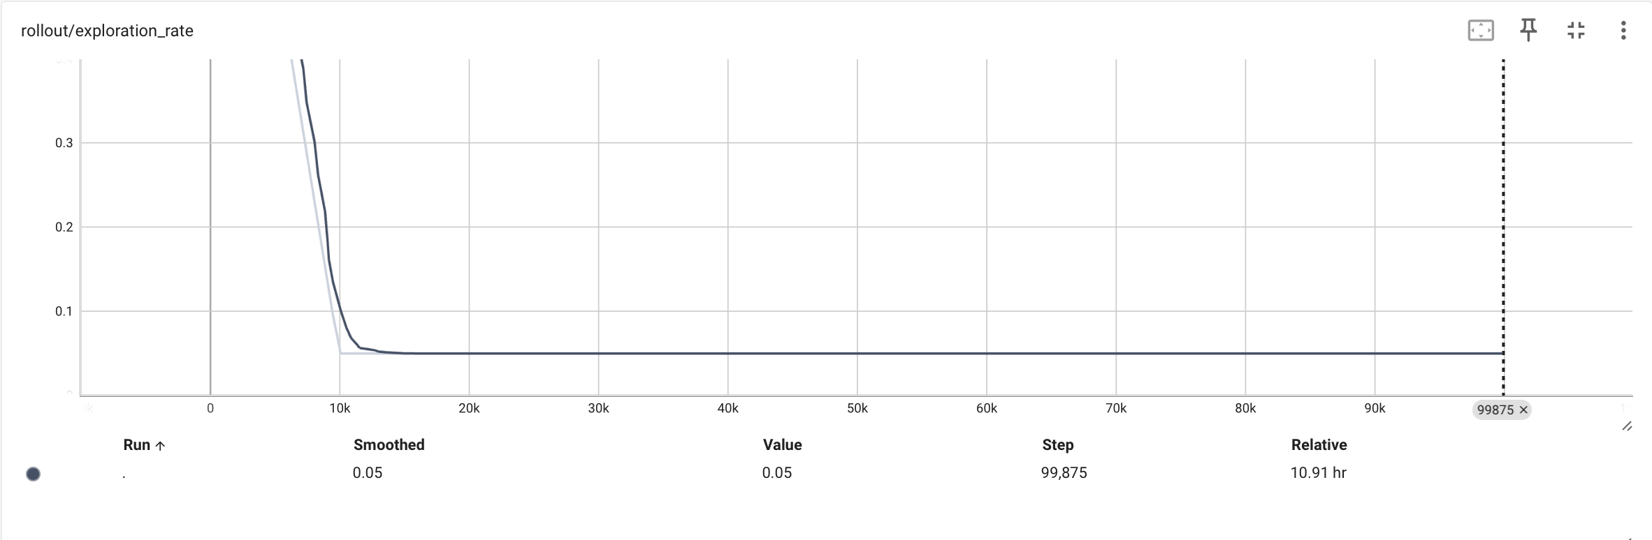
Let’s Talk Graphs – Exploration Rate

Slide 23
Challenges
Similar challenges compared to PPO
Computation power and resources that we have are not enough to run the training model
Model converges to the optimal value after 50,000 iterations which will take days to run on a computer with high enough capabilities
Our school laptops are not able to run such high number of iterations
RAM is not enough

Slide 24
Conclusion - Lessons Learned – PPO vs DQN
Theoretically DQN is supposed to perform better than PPO, and it seems like through our exploration this has been the case
DQN algorithm took necessary actions and did it more accurately
Although, we were not able to reach the upper limits of training because of lack of resources, it has in general been true

Slide 25
Conclusion – Wrapper Strategies
Wrapping the environment and the agent within a few strategies has been very interesting
We reduced the computational load for by about a half!
Gray scaling and Frame Resizing have helped us achieve this idea of cutting down the data processed without hurting the results we would achieve
Frame Stacking wrapper helped us achieve a memory-like feature for the agent and helped with seeing further

Slide 26
Conclusion – Overall
We learned about numerous concept of reinforcement learning and how to evaluate rewards
The reward function for Mario is very complex, considering how many different thing we need to consider
It was designed by the writers of PPO and DQN respectively and the software for the reward function is owned by them
Both the algorithms do a very good job at trying achieve convergence, DQN being the overall better, but this decision is heavily based on the action space chosen and the description of the environment

